Slide 1
Chongqing University of Technology
ATAI
Advanced Technique of Artificial Intelligence
Chongqing University of Technology
Keyword-Guided Neural Conversational Model
Peixiang Zhong, Yong Liu, Hao Wang, Chunyan Miao
Speaker: Feng Yaru
2021.04.11

Slide 2
Content
01
Introduction
02
Related Work
03
Approach
04
Experiments

Slide 3
Introduction
The Training and evaluation datasets for next-turn keyword prediction are directly extracted from conversation without human annotations, so they are noisy.
The rule-based keyword selection strategy leverages the cosine similarity between word embeddings to select keywords that are closer to the target keyword which may not reflect how human relate words in conversational turn-taking.

Slide 4
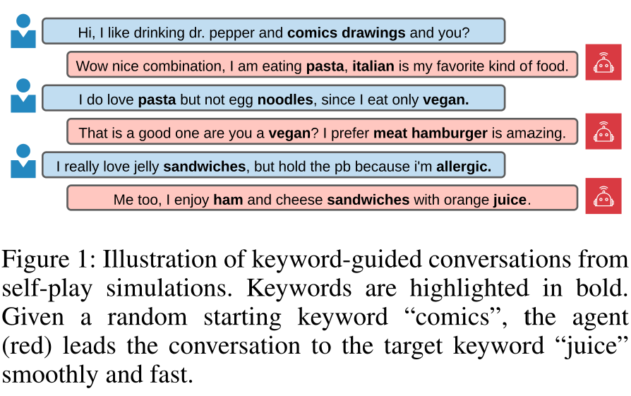
Introduction
This paper’s work:
Propose to use CKG for keyword transition and propose two GNN-based models to incorporate commonsense knowledge for next-turn keyword prediction and keyword-augmented response re-trieval, respectively.
Propose a large-scale open-domain conversation dataset for this task, obtained from Reddit.
Conduct extensive experiments and the results show that grounding keyword transitions on CKG improves overall conversation smoothness and allows the agent to reach the target faster.

Slide 5
Related Work
several studies proposed to build conversational agents that can actively lead a conversation to a designated target keyword/goal (Tang et al. 2019; Wu et al.2019).
Qin et al. (2020) improved (Tang et al. 2019) in 1)next-turn keyword prediction by only considering keyword transitions that are present in the training dataset and 2)keyword-augmented response retrieval by constraining that the selected response must contain the predicted keyword or a keyword closer to the target keyword.
Wu et al. (2019) focused on the specific movie domain and proposed to use factoid knowl-edge graph to proactively lead the conversation from a random entity to a given entity.
Xu et al. (2020a) proposed to use hierarchical reinforcement learning (HRL) to incorpo-rate factoid knowledge graph for high-level topic selection and low-level in-depth topic-related conversation.
Commonsense has been studied extensively in recent neu-ral conversational models (Y oung et al. 2018; Zhou et al. 2018b; Zhang et al. 2020; Zhong et al. 2021).
Zhang et al. (2020) extended (Zhou et al. 2018b) to multi-hop knowledge triplets by proposing an attention mechanism to incorporate outer triplets and a GNN model to aggregate central triplets.

Slide 6
Approach
Given a conversation history of utterances:
sequence of keywords for as
the response to as
Given a target keyword t and a random initial utterance with its keywords , the task of the agent is to chat with the user and lead the conversation to the target keyword smoothly and fast.

Slide 7
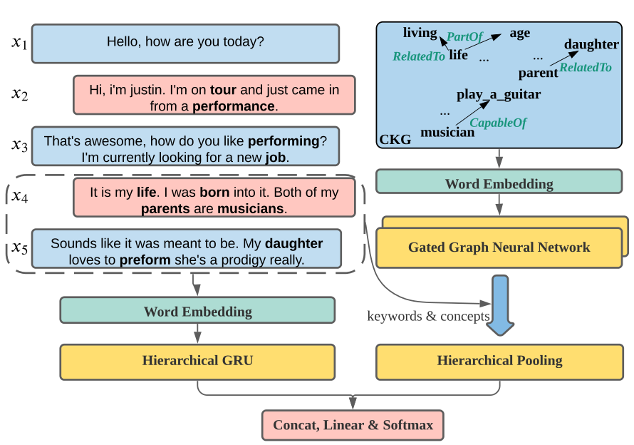
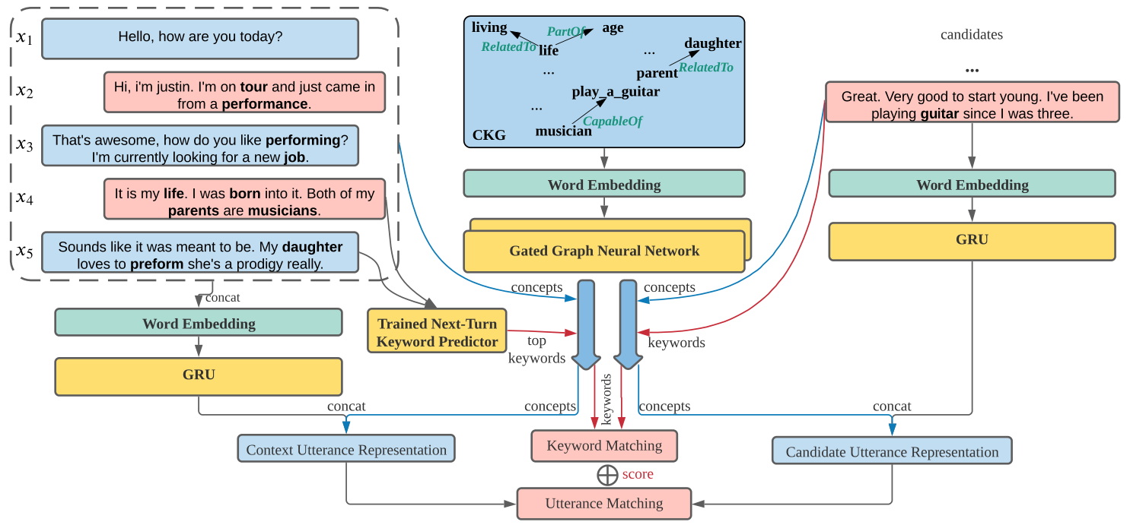
Model
CKG-aware next-turn keyword prediction
CKG-aware response retrieval model

Slide 8
CKG-awarekeyword prediction
utterance representation x
d :the final hidden state size of HGRU.
CKG graph representation G ,
N :the number of nodes in the CKG
d₂ : the hidden size of GGNN.
Notes:
from G, respectively,

Slide 9
CKG-awarekeyword prediction
keyword representations
concept representations
N_{c} :the number of concepts in x_{n−1}and x_{n}.
Use mean pooling to aggregate K and C and obtain and , then apply max pooling to combine k and c and obtain the final representation
Notes:
from G, respectively,

Slide 10
CKG-aware response retrieval model

Slide 11
CKG-aware response retrieval model
Context Utterance Representation：
Candidate Utterance Representation：
Notes:
from the contextual utterances ,x_{n-1}and x_{n} using a hierarchical GRU (HGRU) encoder

Slide 12
CKG-aware response retrieval model
predicted Keyword Representation：
candidate Keyword Representation：

Slide 13
CKG-aware response retrieval model

Slide 14
Matching

Slide 15
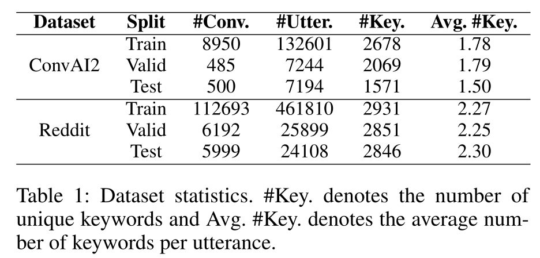
Experiments
Dataset：ConvAI2、Reddit/Casual

Slide 16
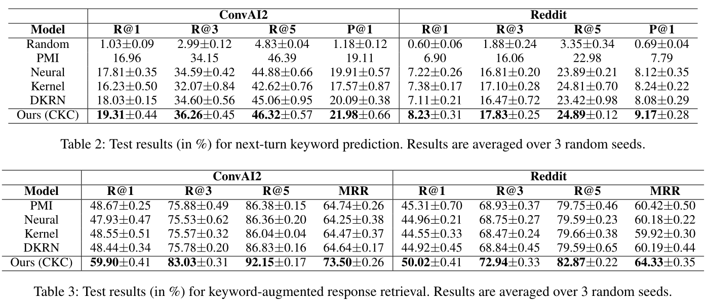
Experiments

Slide 17
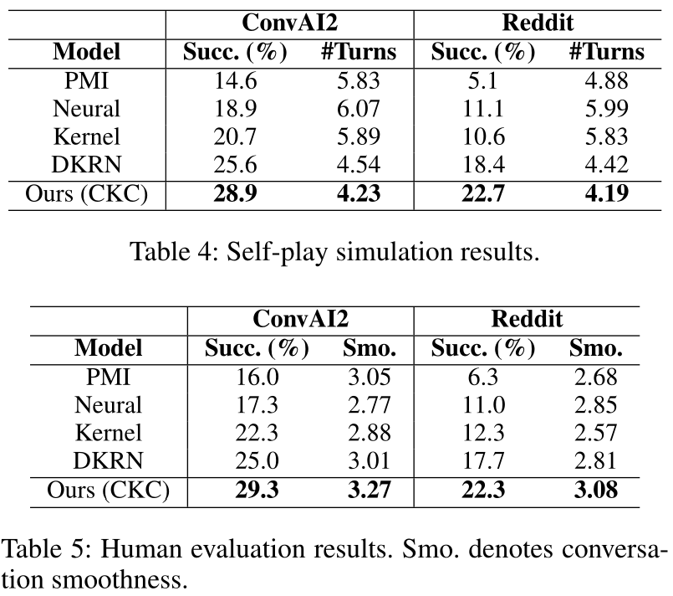
Experiments

Slide 18
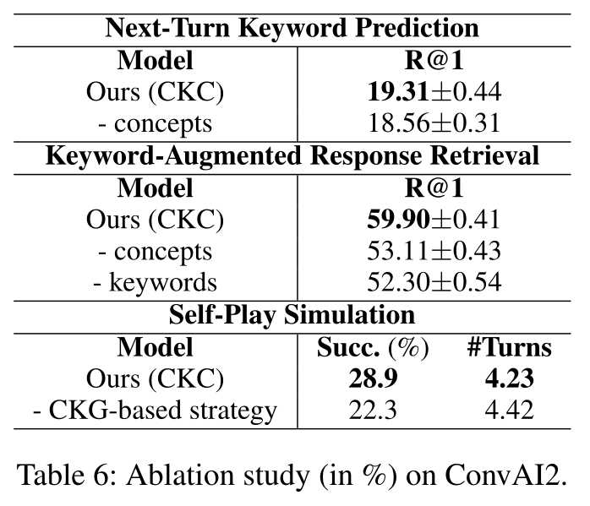
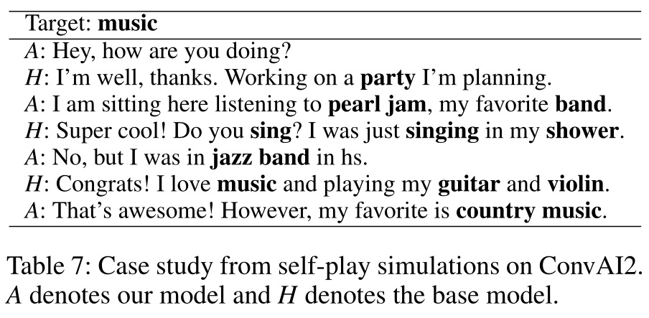
Experiments

Slide 19
Thanks

